Slide 1
Misoperation Workshop
Commission Testing Panel

Slide 2
Panelists
Moderator – Rich Bauer, NERC
Panelist – Alan Wayment, PacifiCorp
Panelist – Chris Fleenor, Tucson Electric Power
Panelist – Rafael Pineda, Pacific Gas and Electric
Panelist – David Penney, Texas Reliability Entity

Slide 3
Part 1 - Ground Rules
Each panelist will give a presentation.
The audience, panelist, and moderator can interact and ask clarifying questions.

Slide 4
Human Performance Misoperation Reduction Efforts in Texas RE
David Penney, P.E.
Texas Reliability Entity

Slide 5
Does this sound familiar?
A new circuit breaker was installed to change a capacitor bank from a single bus-single breaker configuration to a double bus-double breaker configuration.
Contractor failed to program the capacitor bank relays to trip the new circuit breaker.
A fault occurred on the capacitor bank, however the new breaker did not trip.
Remote Zone 2 and Zone 3 relays eventually cleared the fault, resulting in the loss of two generators and 137 MW of load.

Slide 6
How Does Human Performance Impact Protection System Misoperations?
All aspects of Protection Systems are affected by Human Performance
  Design
  Equipment Selection
  Installation
  Commissioning
  Settings
  Modeling
  Maintenance
A misoperation can result from errors at any of these stages

Slide 7
What Types of Human Performance Issues Are We Seeing During Commissioning?
Rule-based errors
  Inadequate work practices, procedures, and checklists
Knowledge and Skill-based errors
  Modeling errors
  As-left personnel errors
Change management
  Work plans do not account for field conditions
  Project schedules too compressed
  Scope changes

Slide 8
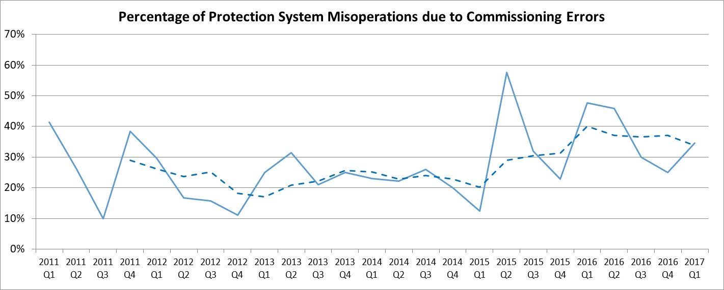
Commissioning Misoperation Trend
Since 2011, ~ 30% of the total misoperations in TRE were due to commissioning errors

Slide 9
Commissioning Misoperation Examples
Category | Misoperation | Cause
CTs | 345kV Auto tripped during a non-fault condition 138kV line overtrip | Incorrectly wired CTs in a 138kV circuit breaker that was recently replaced CTs left in the shorted position after construction Incorrect CT ratios and wiring errors is one of the most common causes of misoperations.
Settings | Multiple 138kV line overtrips | Trip equation in relay did not match the issued setting Breaker failure transfer trip inadvertently placed in service without applying settings Technicians failed to apply settings sent from engineering to the relays Percentage of misoperations due to As-left personnel errors has seen a marked increase over the last two years.

Slide 10
Commissioning Misoperation Examples
Category | Misoperation | Cause
Trip testing | 138kV bus differential failed to trip for a bus fault | Relay outputs not programmed correctly for a newly installed breaker, resulting in loss of two generators and over 100 MW firm load Failures to trip for bus differential and breaker failure schemes can have severe system consequences.
Documentation | Multiple 138kV line overtrips | Field wiring did not match the engineering drawings on which the settings were based Zero-sequence polarization used on one terminal and negative sequence polarization used on the other terminal Pilot relaying disabled on one end of the line for construction project

Slide 11
How Can We Improve?
Commissioning plans
  Procedures
  Checklists
In-service readings
Individual element and System-level testing (e.g. End-to-end tests)
Documentation (e.g. As-builts)
2nd party review

Slide 12
Future State
A new circuit breaker is installed to change a capacitor bank from a single bus-single breaker configuration to a double bus-double breaker configuration.
Contractor programs and trip tests the capacitor bank relays to trip the new circuit breaker per the commissioning plan.
Substation owner witnesses and verifies the commissioning tests.
A fault occurs on the capacitor bank and both breakers trip correctly.
No Misoperations !!!

Slide 13
Commissioning Notebook
Alan Wayment
Rocky Mountain Power

Slide 14
Commissioning Notebook
Four score and seven years ago (except for the Four Score) our fathers brought forth on this company, a new commissioning process, conceived in responsibility, and dedicated to the proposition that all commissioning efforts are created equal.

Slide 15
What We Were Doing
GSU transformer was nearly damaged because testing results were not reviewed properly and the field personnel decided some tests were not necessary
History of performed testing was difficult to locate
Review of testing results needed improvement

Slide 16
Creation of the Commissioning Notebook
Required testing is decided by a panel of experts for each project
Testing results are triple reviewed and saved in a SharePoint program
Asset Management functions are integrated into the program
Plan-Execute-Measure-Correct

Slide 17
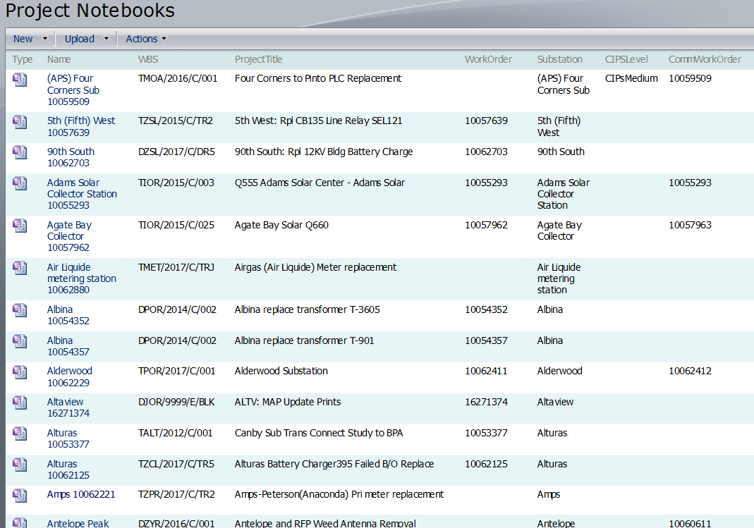
Notebook Project List

Slide 18
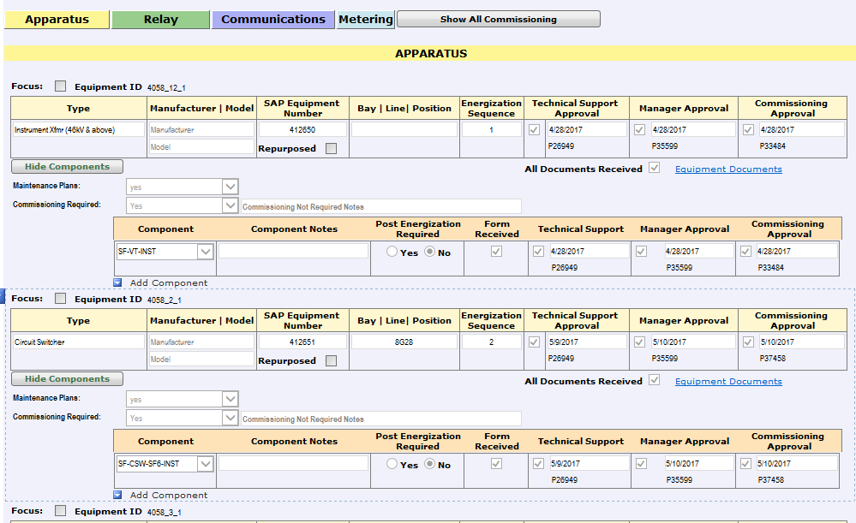
Approval form

Slide 19
In Closing
Evolved from non-formal approach to commissioning to a ridged, very formal process
1868 completed commissioning notebooks
The battles continue (CIPs) but we are winning
Questions and maybe an answer

Slide 20
People and Training - Misoperation Reduction Efforts at TEP
Chris Fleenor, Tucson Electric Power

Slide 21

People are Retiring

Slide 22
Our Business Objective
The Benefits?
Reduced costs over time
More control
Employment of recent graduates
  Educated on the latest technologies
  Who we can educate on our processes / protocol
In-house vs. outsourced expertise (a key part of our knowledge management strategy)
Engineering jobs for our community
To build a stronger, in-house Engineering capability

Slide 23
Training Building Block
Compensation model attractive for career path to TEP full-time
Compressed Talent Development Time
Immersive Training
Developing training using best practices from industry experts
Talent Acquisition with a focus on Engineers with an aptitude for “engineering”

Slide 24
How?
Industry Expert SMEs
Project Focused Training
Outcomes Based Training Model

Slide 25
Rotation Plan
Then participants will rotate through the core rotations (in a different order, so that one group is not overloaded at any time).
Final “Exposure” Rotations
Substation Engineering
With exposure to:
Substation Construction
Asset Management
Distribution Planning, Energy Services , and Renewables
With exposure to:
Design
Line Construction
Protection and Metering
With exposure to:
C&M
Relay / Electronics
Automation and Communication
With exposure to:
C&M
Relay / Electronics
Project Management
With exposure to:
Resource Mgmt Team
Construction Mgmt / Outside Services
System Control and Reliability
With exposure to:
Transmission Planning
EMS
Civil
Generation
Land

Slide 26
Commissioning
Pre-checkout
Checkout
Load Checks

Slide 27
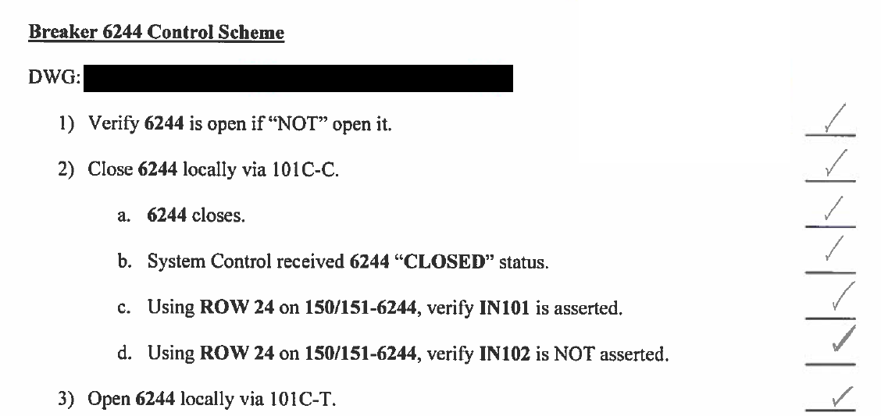
Check Out

Slide 28


Chris Fleenor
Engineering Manager – Protection and Controls
Email: CFleenor@TEP.COM
Phone: (520) 884-3943

Slide 29
Human performance and the challenges of maintaining bus differential protection during major construction
Rafael Pineda, P.E.
Pacific Gas & Electric

Slide 30
Least Cost solutions and demands on competency
In the utility world, least cost solutions often place high demands on competency of personnel from perspective of engineering, operations, maintenance, and construction.
At PG&E, the double bus/single breaker (DBSB) configuration is a prime example.
The DBSB configurations were typically applied to larger stations to address the high cost of circuit breakers coupled with relative low cost of disconnect switches.

Slide 31
Double Bus Single Breaker Bus Configuration
Bus 1-D
v
v
Bus 2-D

Slide 32
DBSB Differential Protection
PG&E applies high-impedance bus differential protection to DBSB. Most of these schemes are electromechanical PVD (G.E.) or KAB (ABB).
These PVD/KAB schemes are highly reliable and rarely misoperate
  Standard Design in place for many years
Human error is usually the cause of false bus differential operations

Slide 33
DBSB Differential Protection
87B-1D
Bus 1-D
v
v
Bus 2-D
87B-2D

Slide 34
The Project
In 2006, PG&E embarked on a major project at Newark substation, one of our largest transmission substations, to replace the 1930s-vintage control building with five modular control buildings housing all-new relay and controls throughout the substation yard.
This project was contracted for Engineer, Procure & Construct services.
Newark Sub has a DBSB configuration comprised of:
  230kV two bus sections with a total of 13 elements
  115kV three bus sections with a total of 30 elements
  60kV on bus section with two elements
  11 radial connections out of 43 elements
Newark Substation is located on the eastern shore of San Francisco Bay and services major industrial and hi-tech load

Slide 35
The Plan
Based on stability analysis provided by Transmission Planning, protection requirements called for installation of temporary bus differential scheme to ensure local high-speed bus protection for the duration of construction.
Estimate of $400,000 to be included in the Job Estimate for the temporary bus differential scheme
Lead PG&E protection engineer worked closely with Lead PG&E Electrical Technician to develop the detailed work plan and construction sequence for the temporary bus differential
  Both individuals were highly competent and detail-oriented
  Contractor supported the temporary install at the direction of PG&E leads

Slide 36
DBSB Temporary Bus Differential
87B-1D
(EXISTING)
Bus 1-D
87B-1D
(NEW)
v
IN SERVICE
NOT
IN SERVICE
v
Bus 2-D
87B-2D
(EXISTING)
87B-2D
(NEW)
SLIP-OVER CTS

Slide 37
The Plan
High-level:
  the existing bus differential to remain in service as each bus section element migrated to the new control building.
  Breaker failure tripping of the bus to remain intact
    Required auxiliary relays in new control building to bridge new DC circuits & existing DC circuits
  Bus differential selectivity to remain intact (via auxiliary relays)
  Breaker failure initiate from existing bus differential would not be wired to new control buildings.
  CB spare CTs wired to new control building to new bus differential relays.

Slide 38
Challenges
In spite of protection requirements, the project neglected to include funds for temporary bus differential.
  Project Management & EPC Contractor lobbied for moving forward without temp bus diff
  System Protection successfully negotiated for staying with the original plan
Several circuit breakers (legacy Oil Circuit Breakers) had no spare set of bushing CTs to wire to new bus differential
  Slip-over CTs added

Slide 39

Questions

Slide 40
Results
Temporary bus differential successfully installed with no misoperations.
Two bus differential operations during construction:
  Debris from failed line connector made contact with 115kV Bus
  Operator switching error resulted in bus differential operation

Slide 41
Part 2 - Ground Rules
Interview style format.
The audience, panelist, and moderator can interact and ask clarifying questions.

